Slide 1
LEGO BRICKS DETECTION
Team Members: 1. DEEPTHI PRASANNA (LEAD)
2. THAVAMANI 3. MIDHUN 4. JUNAITHA FATHIMA
MACHINE LEARNING

Slide 2
INTRODUCTION
Artificial intelligence
The simulation of human intelligence in machines
Machine learning
Enables systems to learn from data and make decisions
Deep learning
Uses neural networks to model complex patterns in data.
Notes:
Just Explain What is AI, ML & DL

Slide 3
ARTIFICIAL INTELLIGENCE VS MACHINE LEARNING
Artificial Intelligence
Machine learning
Vs
Computers act on their own
They act according to environment
Systems display cognitive ability
Computers make decisions
It’s an application of AI
Computers observe and analyze
Predict based on previous patterns
Pre-programmed algorithms
Notes:
Just explain difference between AI & ML

Slide 4
MACHINE LEARNING
01
Supervised Learning
It involves training a model using labeled data, where the input-output pairs are known.
Machine learning
02
It is a branch of Artificial Intelligence where systems learn from data to make predictions/ decisions.
UnSupervised Learning
03
It involves finding patterns or structures in data without using labeled examples.
Reinforcement Learning
Trial and error learning process. Trained with fixed datasets and learns from its actions.
Notes:
Explain 3 types and mention that our project comes under supervised learning. Once explained supervised say “CNN and YOLO COMES UNDER SUPERVISED LEARNING”. Once explained unsupervised learning say” K - mean clustering comes under unsupervised learning”. Reinforcement “deep q”

Slide 5
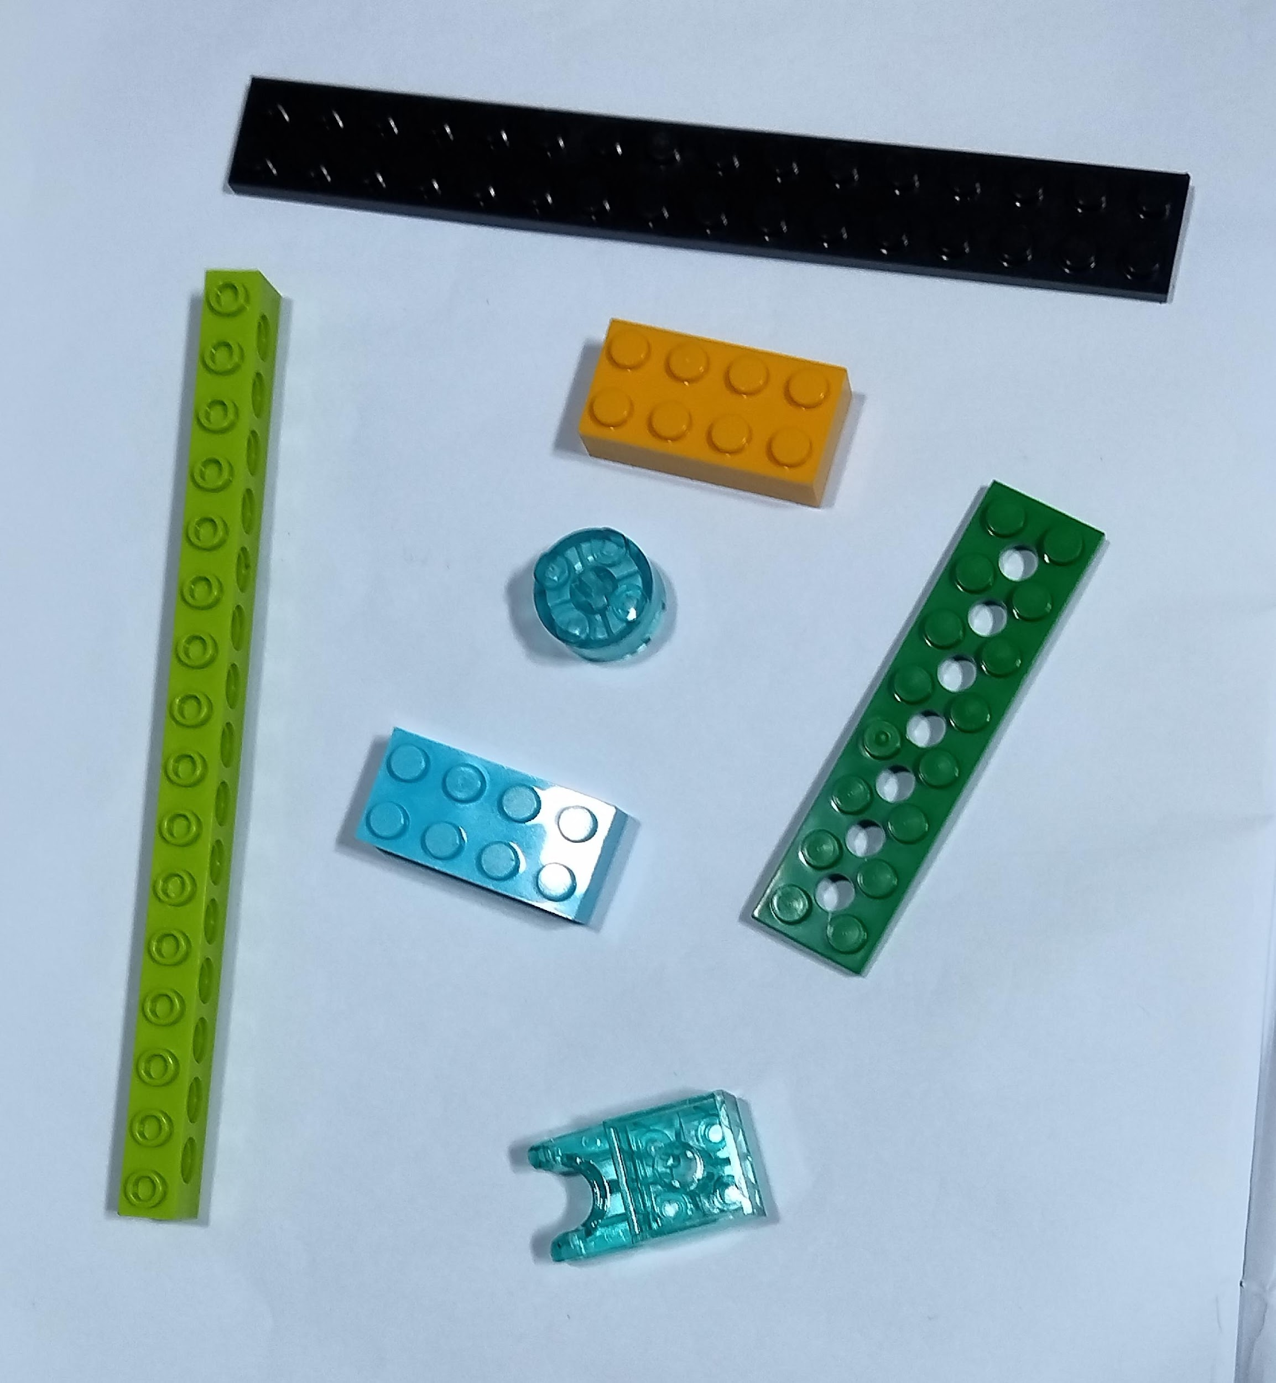
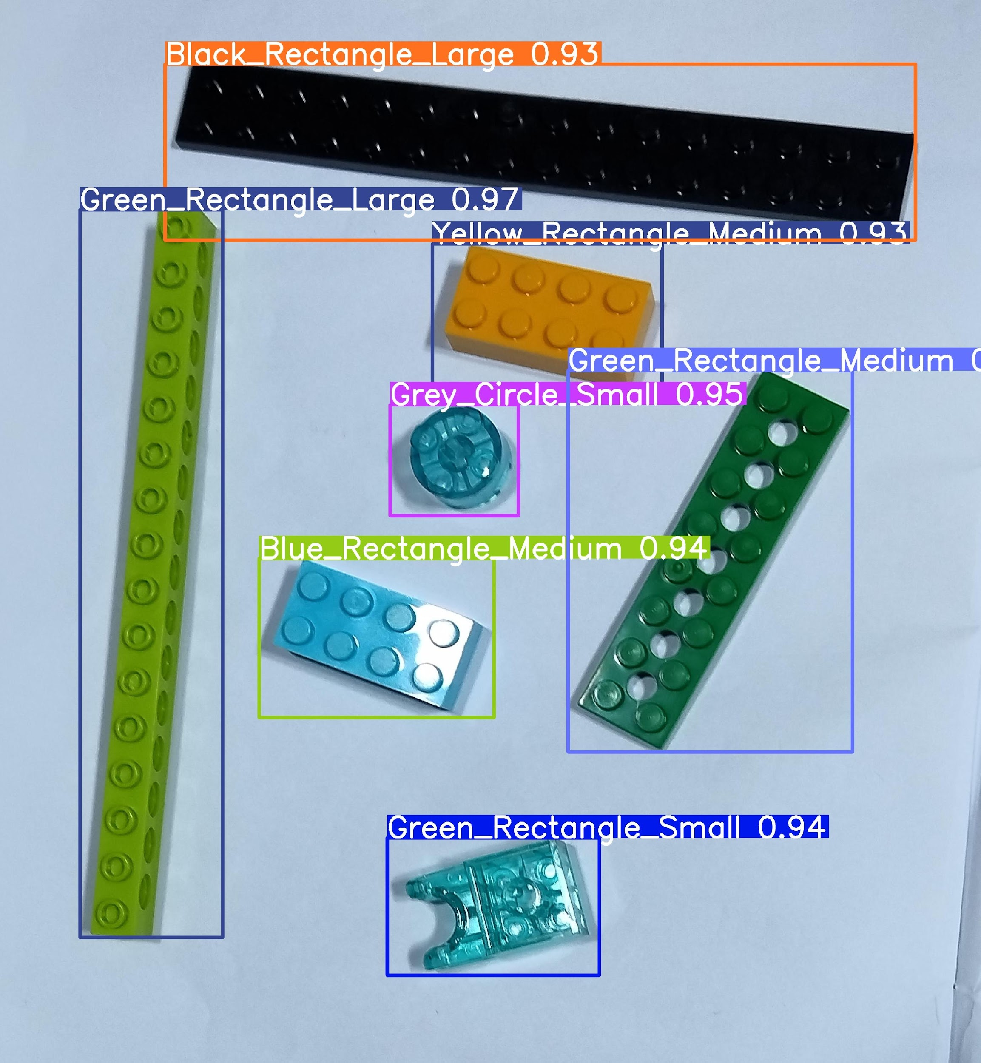
LEGO BRICKS DETECTION
Inputs
Outputs
Image, Video, live Camera, Capture from Camera.
Count, Color, Shape and Size of Lego Bricks.
Input 1
Output 1
Input 2
Output 2
Input 3
Output 3
Notes:
Mention our project objective. What’s the input and how we get the output.

Slide 6
PROJECT WORKFLOW
01
02
03
04
Dataset Preparation
Preprocess Data
Choosing Model
Train the model
Collecting images from various platform
Preprocess data according to project
Choose the best model for the project
Train the dataset with the chosen model
05
06
UI development
Evaluate the model
Evaluate the accuracy of the chosen model
Developing UI elements for the user to interact
07
08
Test the UI
Deploy the project
Test the UI elements that was created
Deploy the project in cloud platform
Notes:
Explain what are the steps involved in our project. No need of detail explanation. Detail explanation can be done in the respective slides

Slide 7
DATASET PREPARATION
Roboflow
It simplifies the process of building dataset.
Collecting Images
kaggle
It is an online platform for data science.
Google Images
Users to find and view images from the web.
Collected images of Lego Bricks from Office.
KADIT
Notes:
Explain roboflow. How we created dataset etc.

Slide 8
PREPROCESS DATA
01
02
Annotation
Resizing
Adding notes, or labels to the images for better accuracy.
Changing the dimensions of an image for faster training.

Slide 9
CHOOSING THE MODEL
CNN
YOLO
A type of Deep Learning model used for visual data,such as images and videos.
It is a real-time object detection system that predicts bounding boxes and class.
CNN Well-Suited for
YOLO Well-Suited for
Image classification, Face Recognition, Feature Extraction.
Real-time object detection, Multi-Object Detection, Boundary Box Prediction.
Notes:
While explaining include some more algorithm like KNN or RNN etc..
And specify these two will be best for detections and specify YOLO as best compare to CNN.

Slide 10
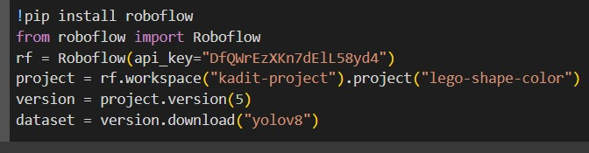
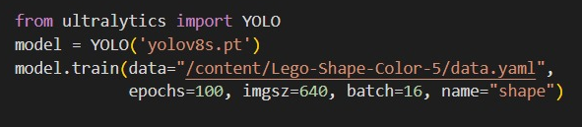
TRAINING THE MODEL
Model
Training
from ultralytics import YOLO
model = YOLO('yolov8s.pt')
model.train(data="/content/Lego-Shape-Color-5/data.yaml",
epochs=100, imgsz=640, batch=16, name="shape")
Notes:
While Explaining include downloading dataset as zip file from roboflow and this API method.
Explain about yolov8s.pt and data.yaml file, epochs, imgsz, batch and name

Slide 11
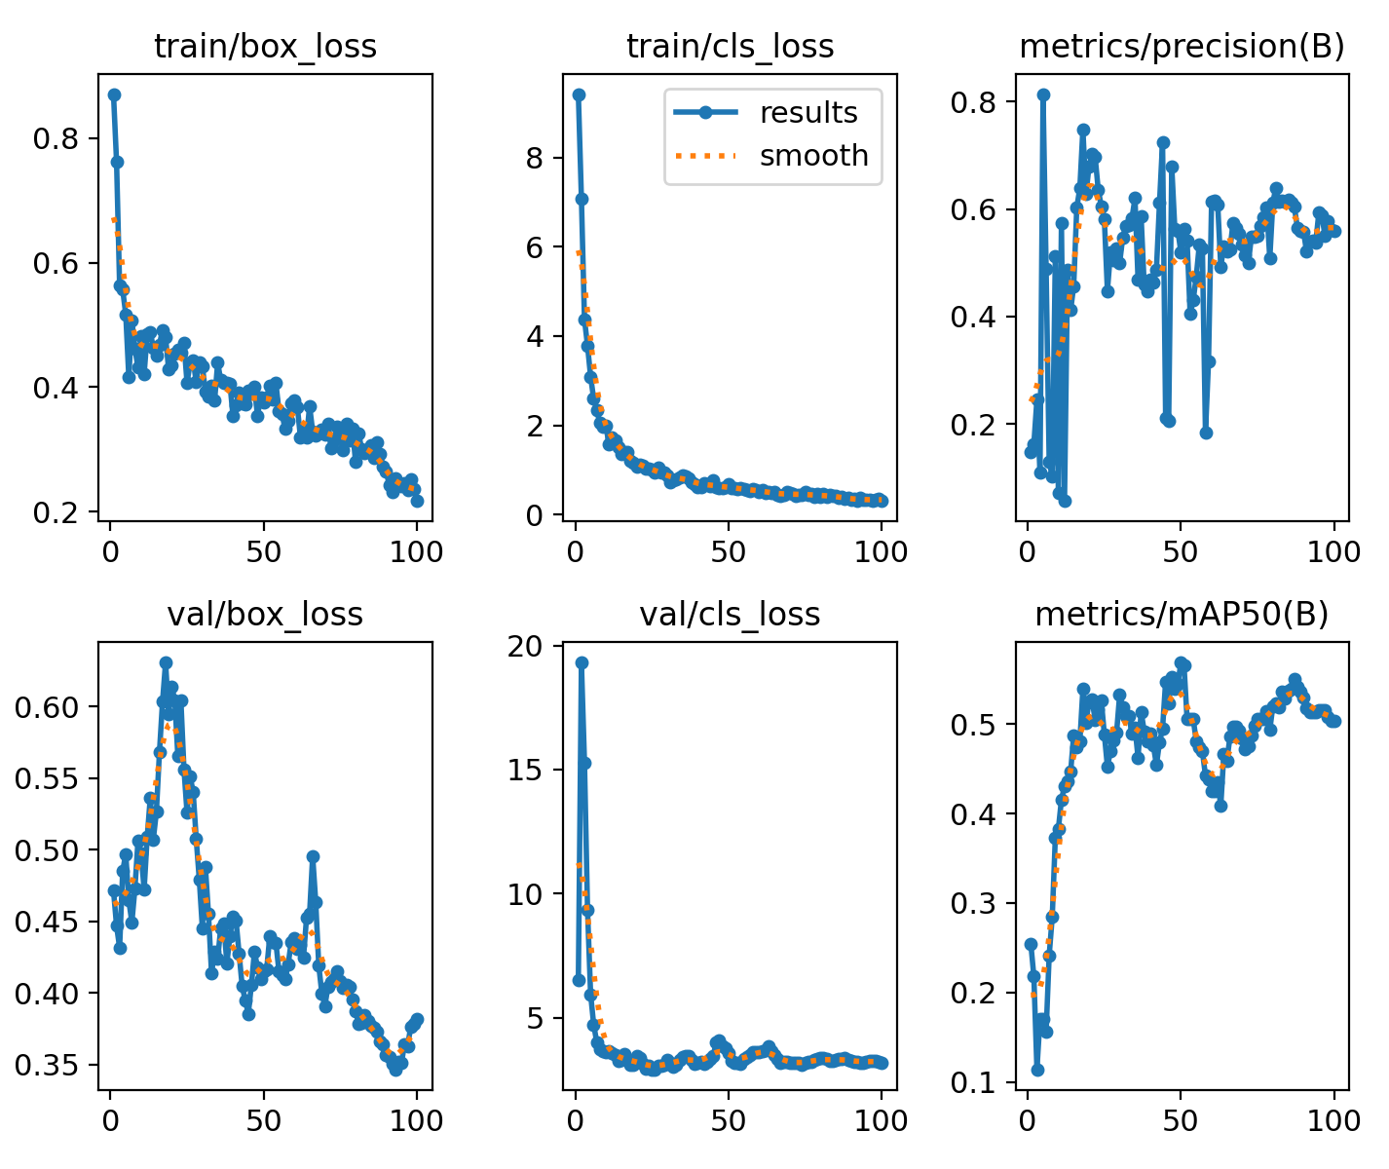
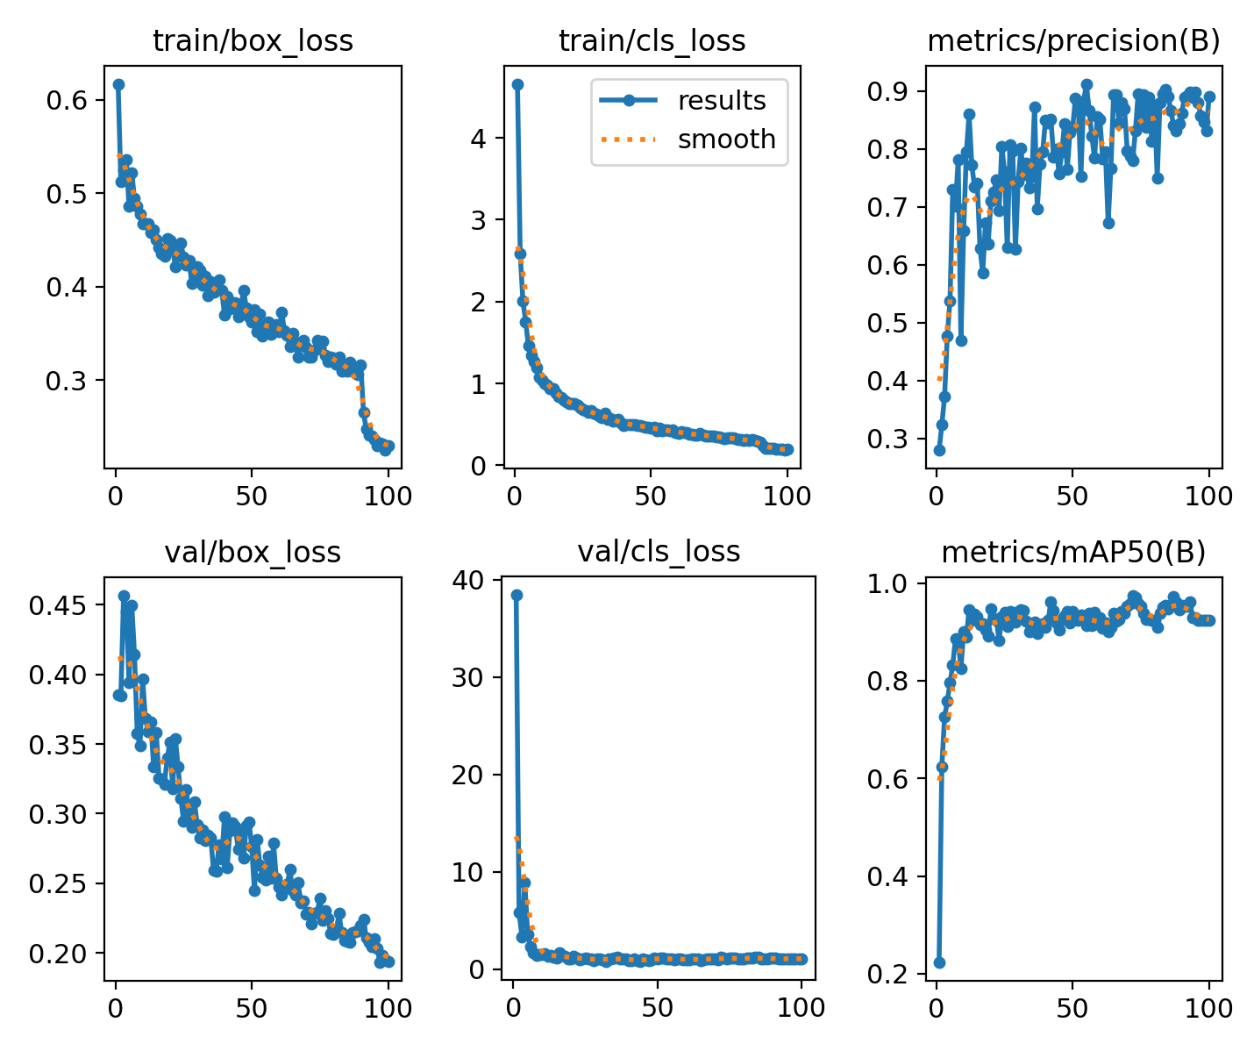
EVALUATE THE MODEL
Previous Plottings
Current Plottings
Notes:
train/box_loss: Losses occurs in bounding box while training. Similarly for val/box_loss (validation bounding box losses)
train/cls_loss: Losses occurs in class name (category) while training. Similarly for val/cls_loss (validation class losses)
Precision: How many images are actually predicted correct
mAP: Mean average precision

Slide 12
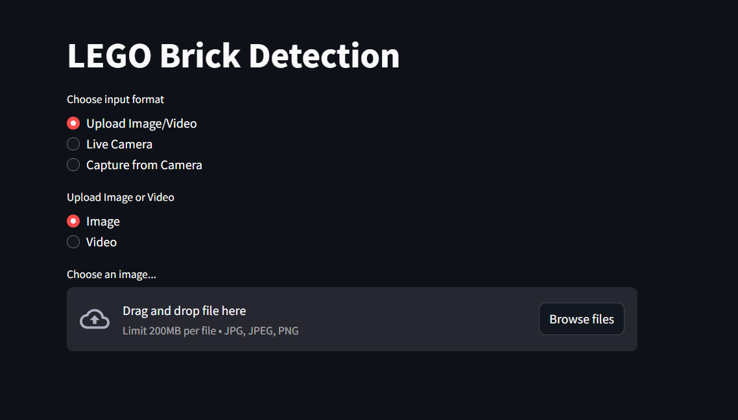
USER INTERFACE DEVELOPMENT
Notes:
In this section we can show our final output running in localhost

Slide 13
DEPLOY THE MODEL
Stremlit cloud :
Streamlit Cloud is a platform that allows users to deploy, share, and collaborate on interactive data applications built using Streamlit, enabling seamless integration with data science and machine learning projects.
Deployed Links :
https://lego-detection.streamlit.app/
https://lego-app.streamlit.app/
Notes:
Explain about streamlit cloud and how we deployed and show the working link. Streamlit is an open-source app framework specifically designed for building and sharing machine learning and data science applications quickly

Slide 14
CONCLUSION
Speed and Efficiency
01
Yolo is fast and suitable for real-time applications, such as detecting and classifying multiple LEGO bricks in images quickly.
Accuracy
02
Training on a high - quality LEGO dataset, YOLO can effectively differentiate between various colors and sizes of LEGO bricks.
Customization
03
YOLO can be retrained on a specific dataset like LEGO bricks, and its labels can be fit the unique taks.

Slide 15


